Slide 1
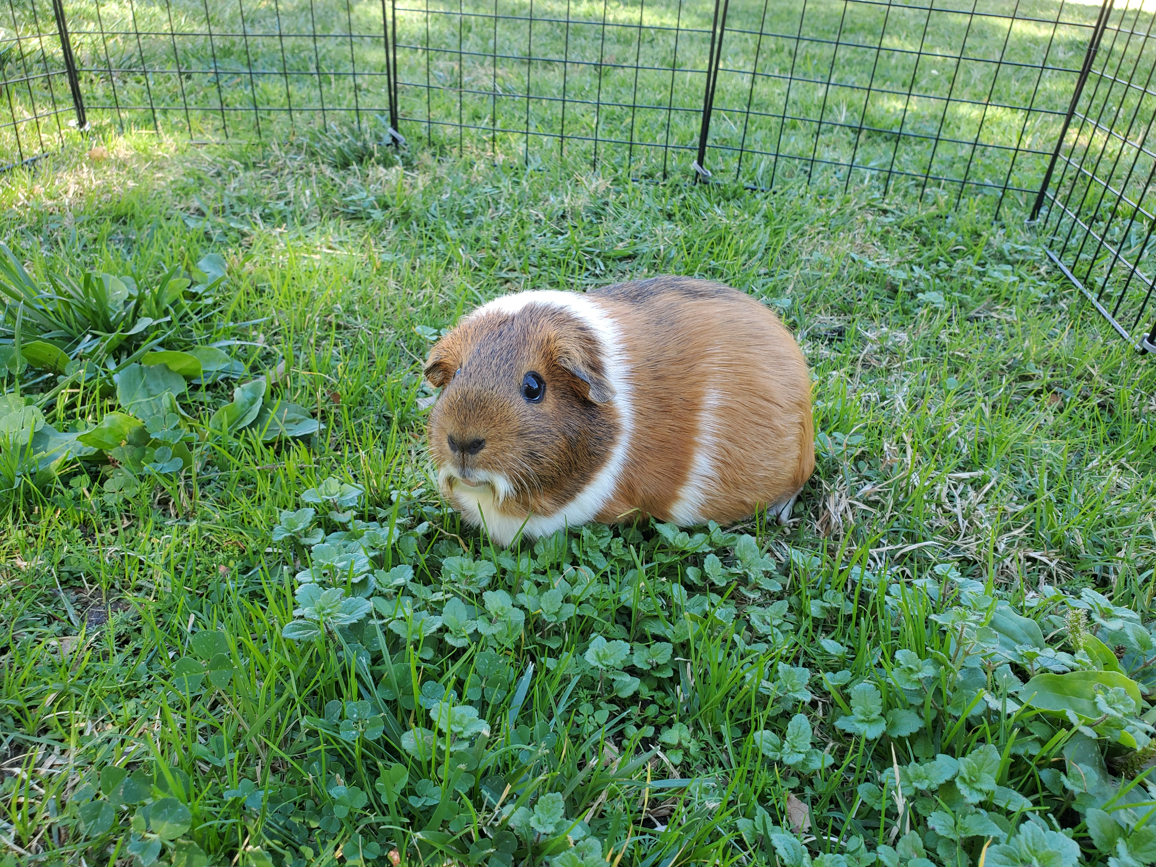

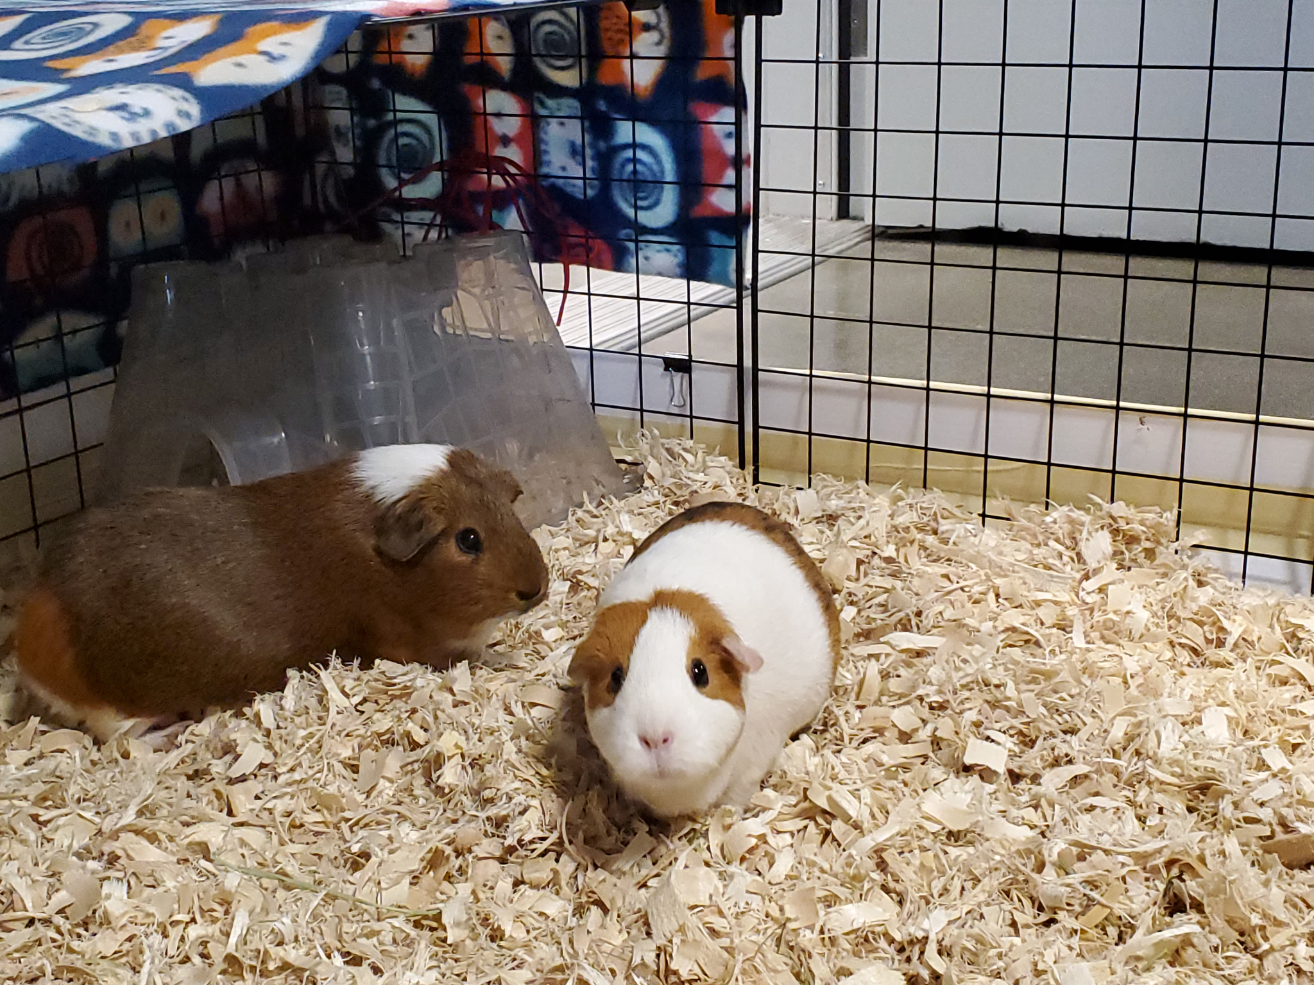
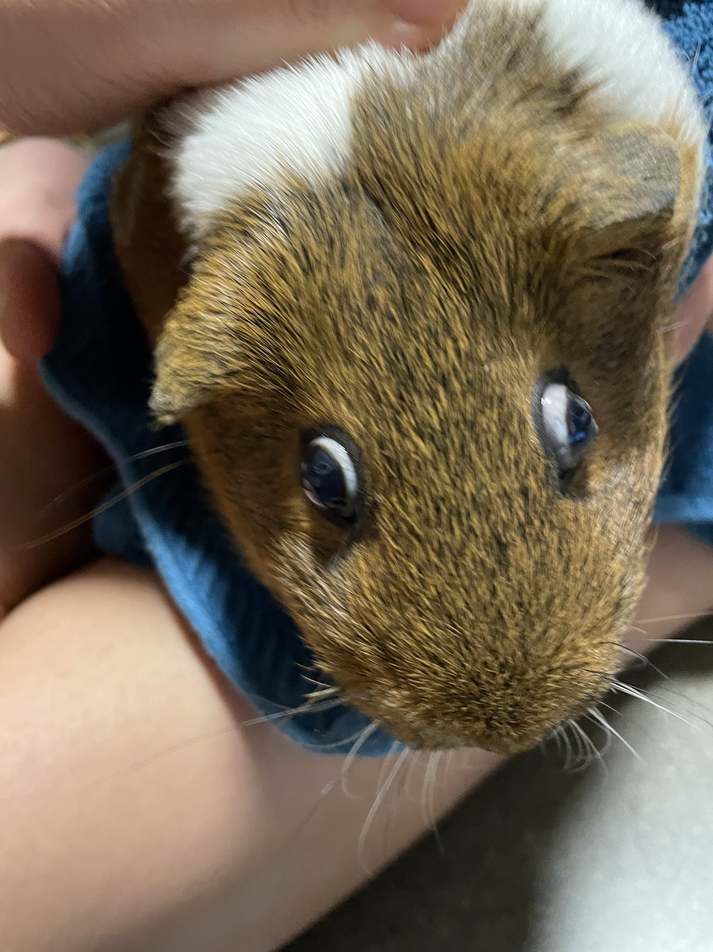
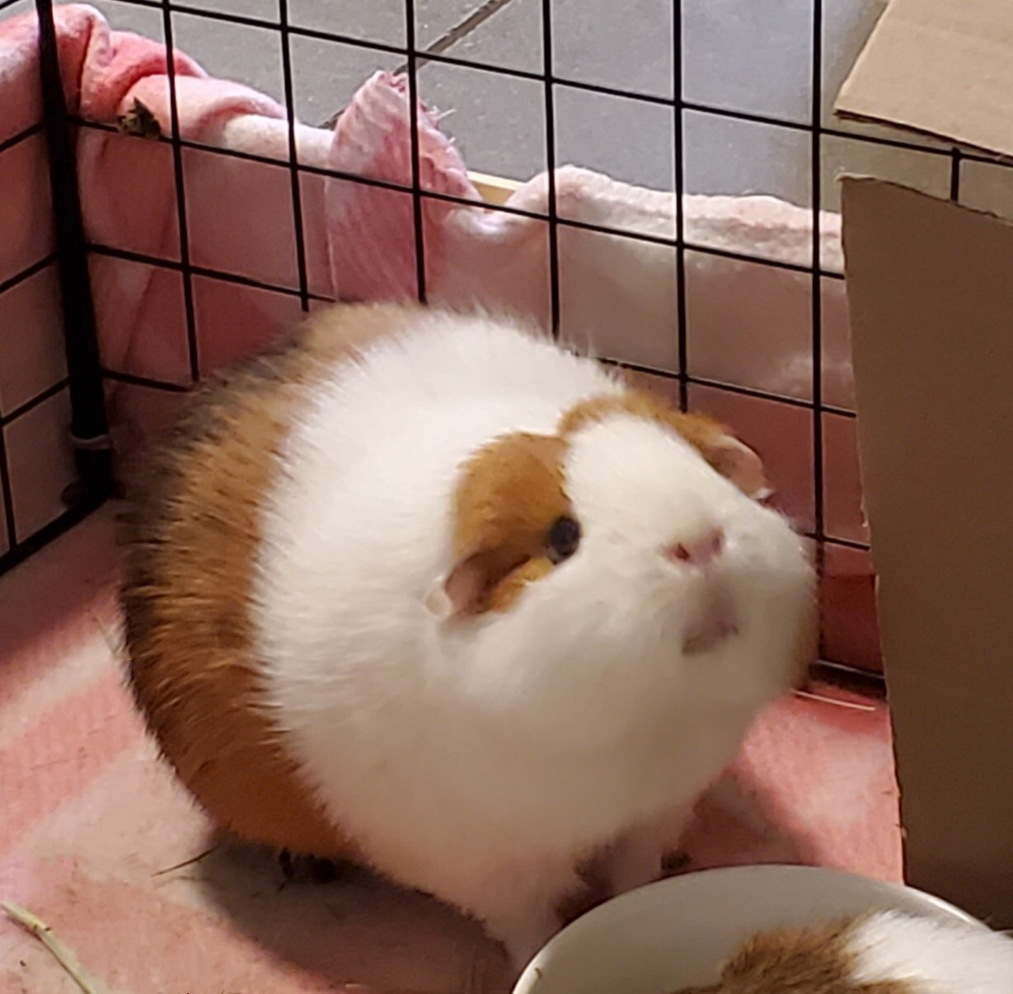

Slide 2


Slide 3
CORE
Climate Online Resources for Education

Slide 4
The Problem
Climate Education
Lack of resources
Disorganized resources

Slide 5
The Solution
CORE (Climate Online Resources for Education)
Upload resources teachers enjoy
Download resources for inspiration or use in classroom

Slide 6
RESOURCES USED
FIGMA
FLASK
HTML
CSS
.OS
Google Cloud
Used to design the website layout
Used to design my app
Used to structure the web app
Used to make everything pretty
Used to sort files
TRIED to use to host my web app

Slide 7
LIVE DEMO

Slide 8
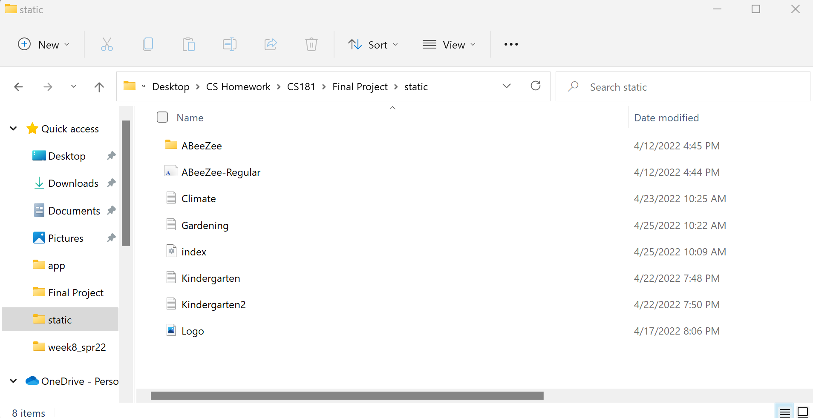
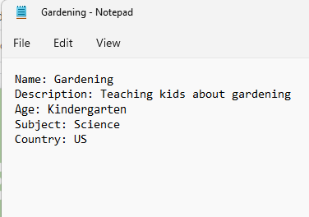
LIVE DEMO

Slide 9
LIVE DEMO

Slide 10
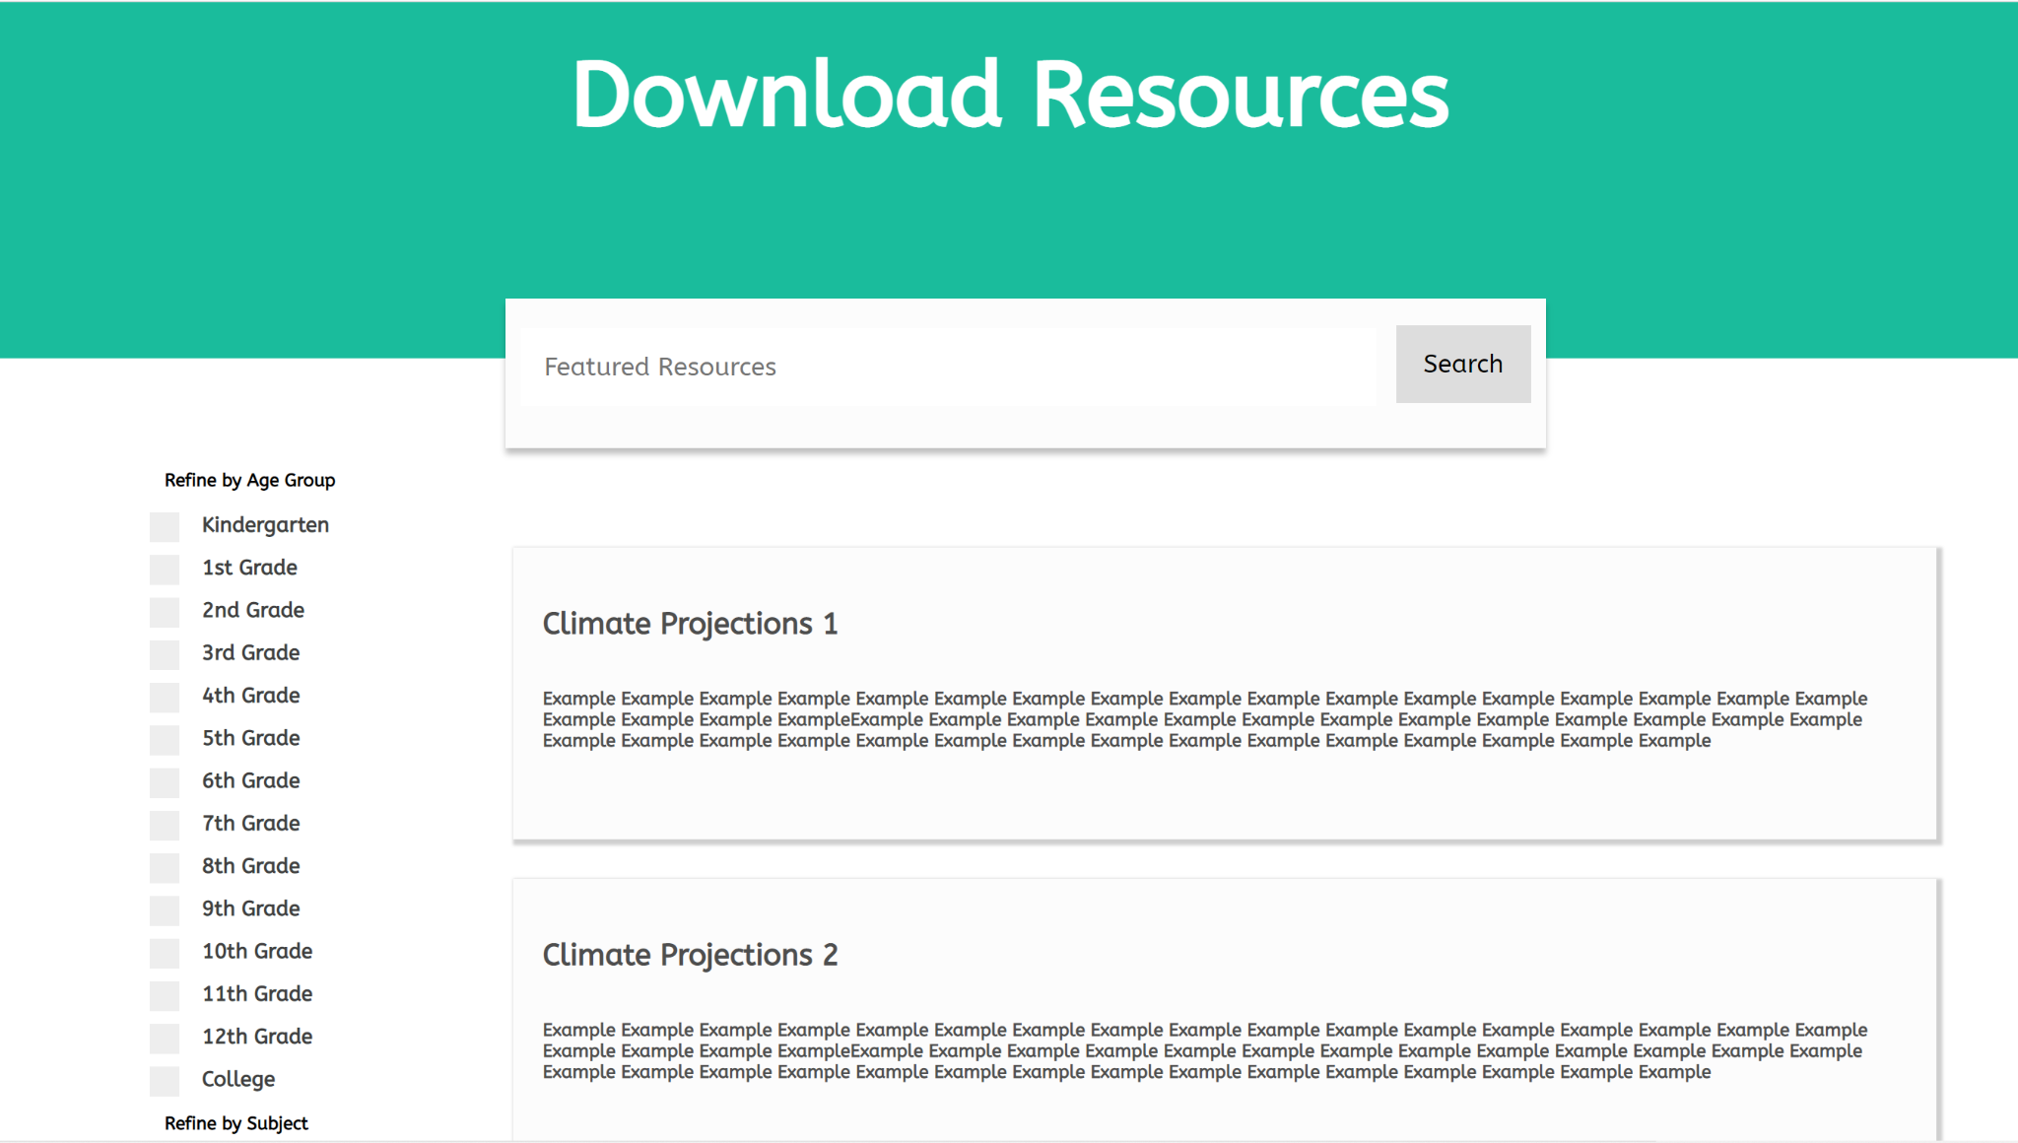
FILE SEARCHING
Keyword Search
FileInfo
key
FileInfo
value parsing

Slide 11
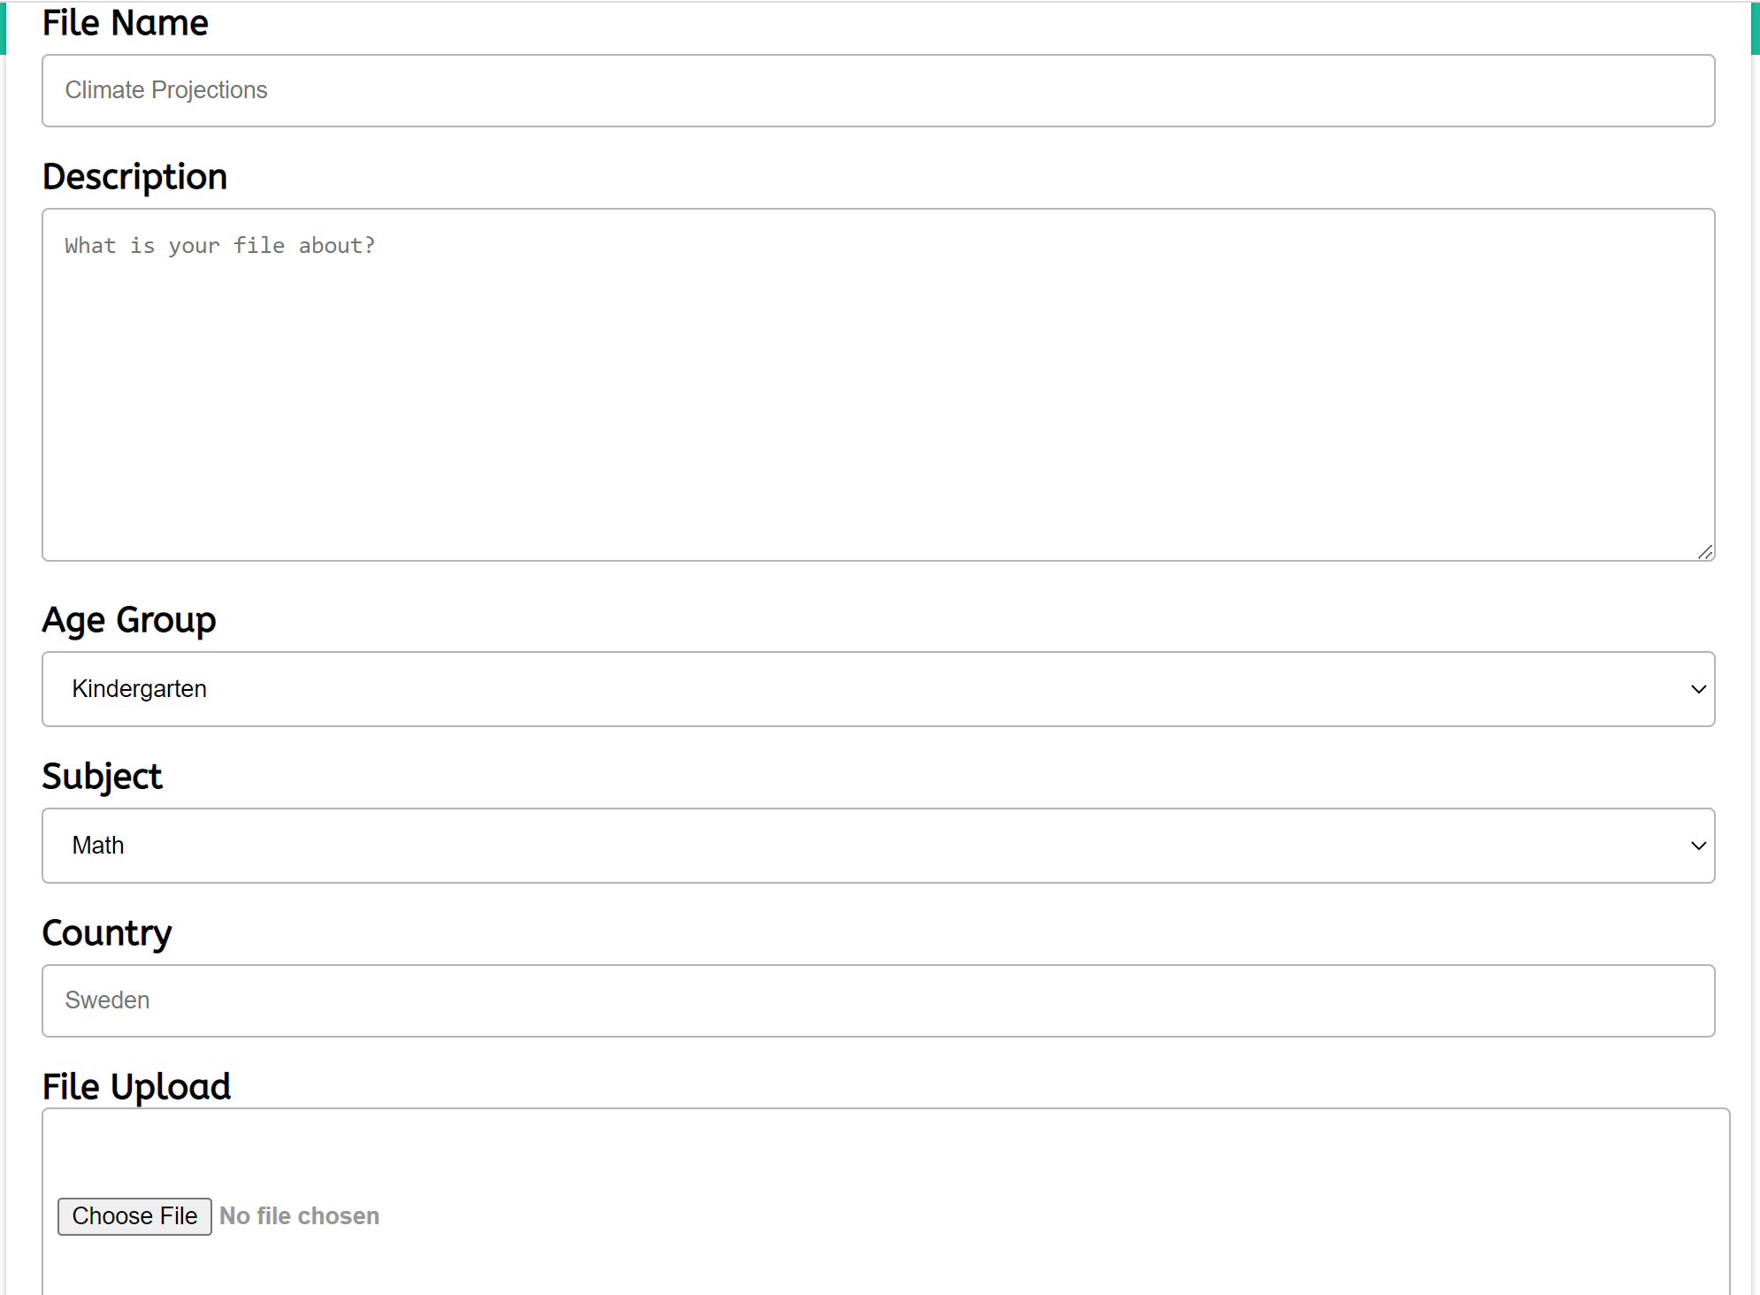
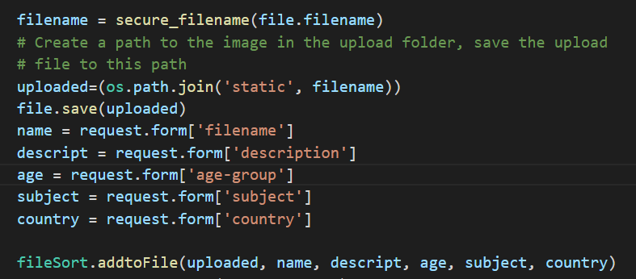
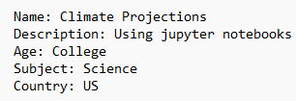
FILE SORTING

Slide 12
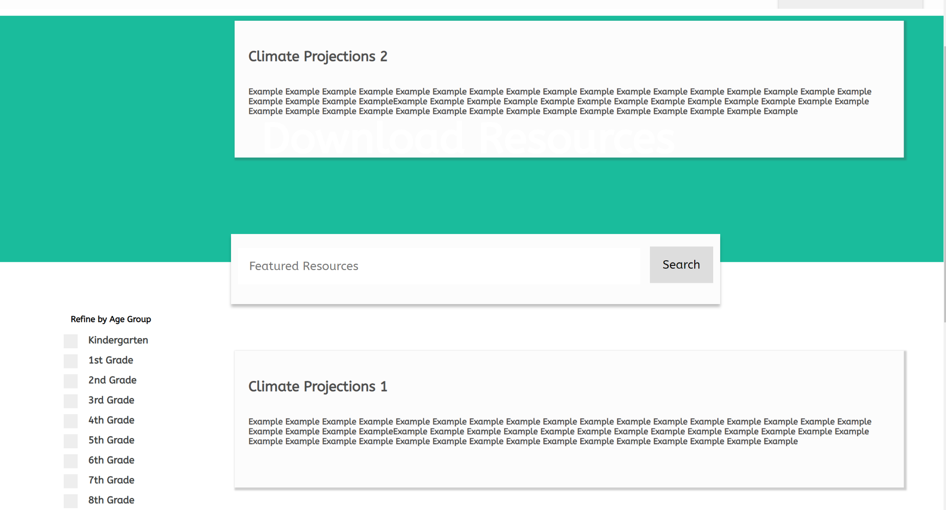
OOPS and YIKES

Slide 13
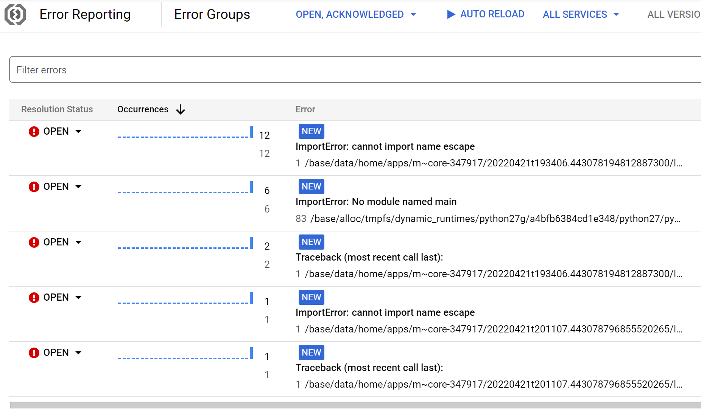

OOPS and YIKES

Slide 14
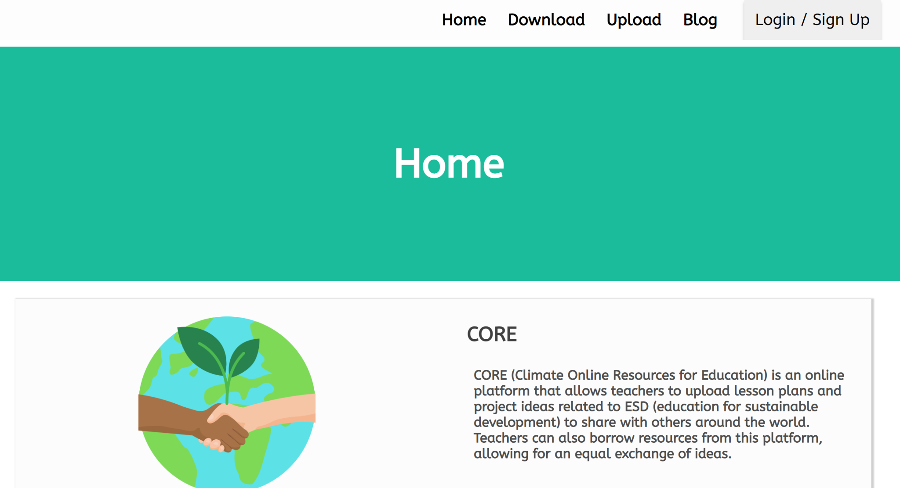
LOOKING FORWARD
MANY THINGS TO DO!
Actually open up the files
Download the files
Handle files other than txt
Upload app to the web

